Slide 1
Dynamic Training for Fraud Detection Models
Wells Fargo logo
Hridita Rubyat
Risk Modeling Group – Fraud & Model Innovation
©2025 Wells Fargo Bank, N.A. All rights reserved. Internal use.

Slide 2
Agenda
Problem Statement and Goal 3
Model Architecture 4
Data Details 5
Approach 6
Key Findings & Recommendations 7
Appendix 8

Slide 3
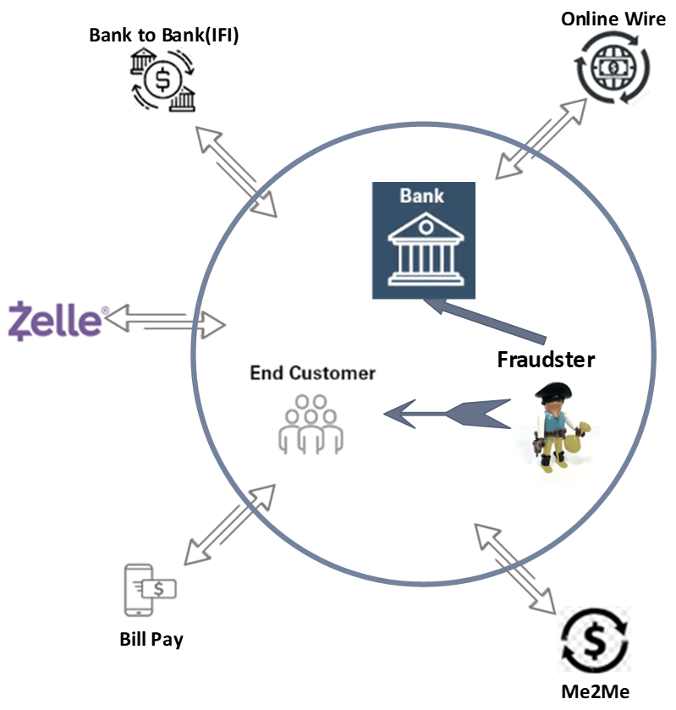
Problem Statement and Goal
The Challenge:
Fraudsters continuously evolve their tactics in Financial transactions.
Traditional ML models fail to keep pace with rapid fraud pattern changes.
Results : Outdated detection, Delayed responses, Financial loss, Reduced trust.
Zell platform’s high transaction volume, real-time nature creates unique fraud prevention challenges.
Key Objective
Explore whether Dynamic/Incremental learning techniques improve the model performance in fraud detection.

Slide 4
Model Architecture
Standardized Architecture
across all models
Why Neural Network?
XGBoost models' limitations in feature expansion
Neural Networks handle complex interactions and high-dimensional data better for dynamic models.
Weight-update Mechanism
Incremental Learning with sequential fine-tuning.
Similar to transfer learning but within same task domain
4-layer Feedforward Neural network
Keras /TensorFlow frameworks
Regularization techniques
Dropout / early stopping
Hyperparameters
Training epochs/ batch-size / learning rates
Initialize new model
Load previous model’s weights
Fine- tune at reduced learning rate
Store current model weights
Adam Optimizer
Backpropagation to update weights
Next training cycle

Slide 5
Data Details
Dataset Characteristics:
Data Source: P2P Zell (Digital Cross-Product Transactions)
Data Pre-Processing:
Time period: April 2023 - April 2024
78 transaction features with 1,423,169 total rows
Down-sampled dataset with 100% fraud and 2% normal transactions
Separation into Train-Valid-Test sets
Null values handled using Median Imputation
Feature Scaling with StandardScaler

Slide 6
Approach
Three distinct models were developed with identical neural network architecture
Model evaluation: October 2023-April 2024 (7 test windows for all models)
Models
Static Model (Baseline)
Incremental Model
Full Train Model
Trained once on historical data (April-August 2023)
Never updated
Initially trained like static model (April-August 2023)
Updated monthly with new data (Sept 2023-March 2024) while preserving previous knowledge.
Retrained from scratch each month using all historical data
Growing dataset with each update

Slide 7
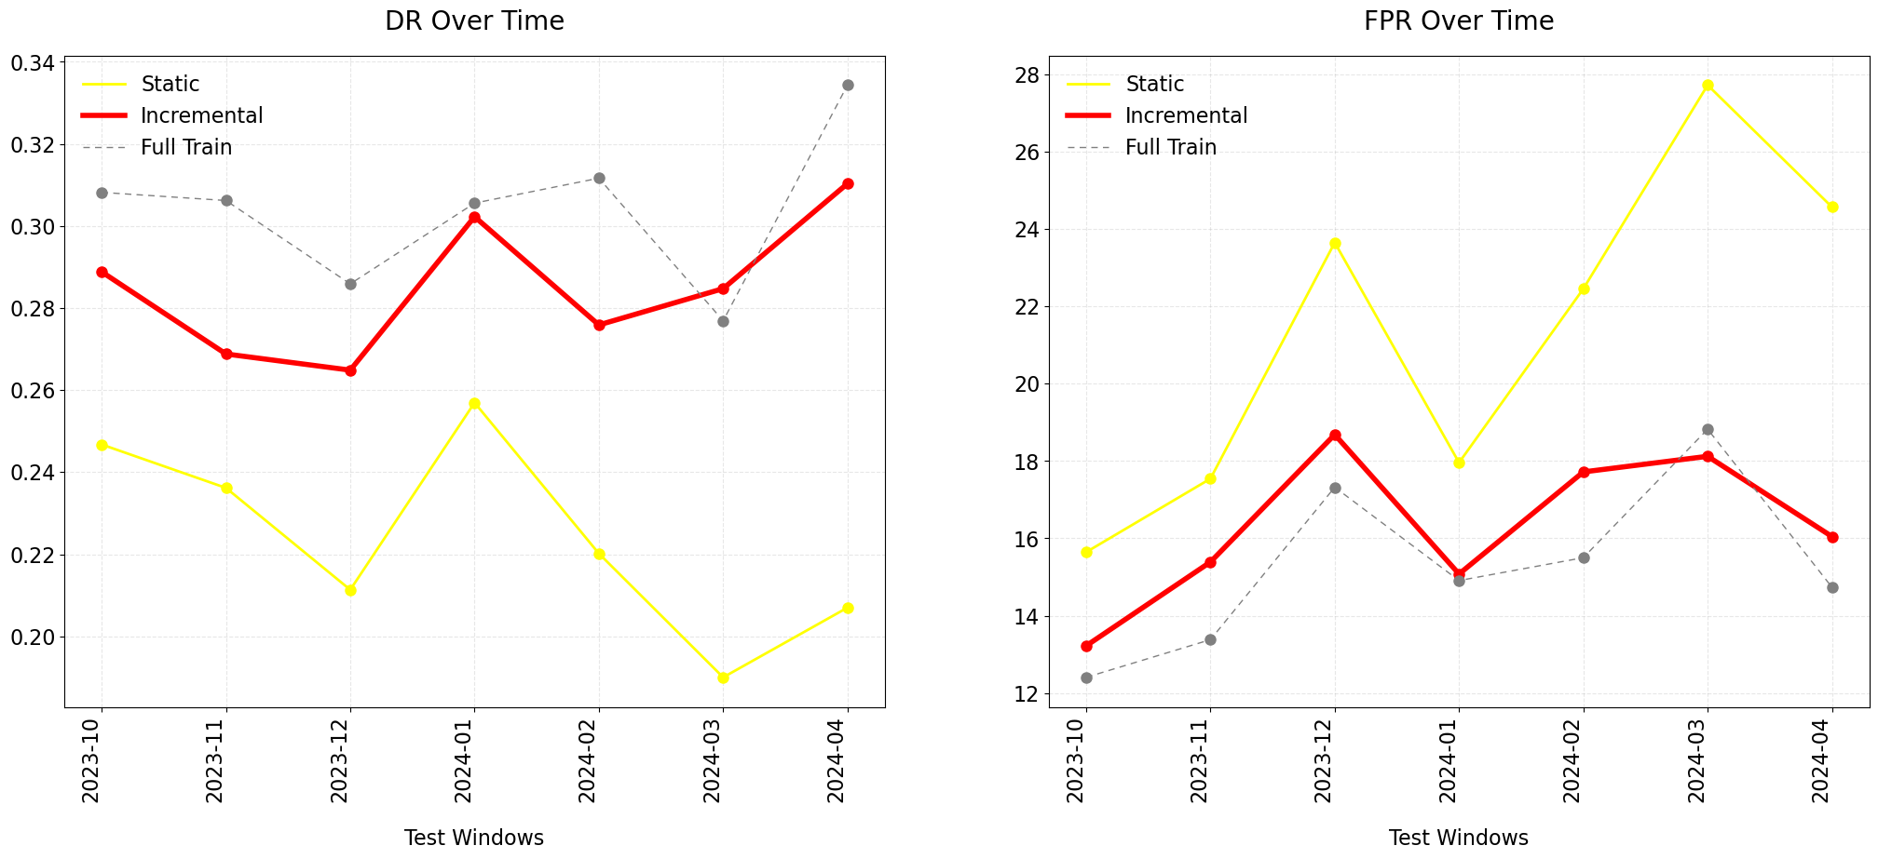
Key Observations & Recommendations
Static model performance declined over time.
Both Incremental and Full train model outperformed static model across all metrics.
Benefits
Improved Fraud Detection. (~5%)
Reduced False Positives. (~5%)
Recommendation
Adopt incremental learning methodologies for fraud detection systems.
Model | AUC | AUC-PR | Detection Rate | False Positive Rate
Static | 0.902 | 0.056 | 0.224 | 21.4
Incremental | 0.924 | 0.087 | 0.285 | 16.3
Full Train | 0.922 | 0.094 | 0.304 | 15.2

Slide 8
Next Steps
Extending implementation of recommended dynamic learning approach to tree-based models.
Integrate advanced techniques like EWC/EWMA and Replay Mechanisms to further enhance model stability.

Slide 9
Risks & Considerations
Catastrophic Forgetting: Incremental models may lose previous knowledge.
Sampling weights to handle Data Imbalance.
Controlled learning rates for integrating new patterns.

Slide 10
Thank you
Wells Fargo logo

